Slide 1

SOCIAL MEDIA USE
& MENTAL HEALTH INSIGHTS
AMONG CANADIANS (2022)
Group : 7
Chinenye Onyedika, Shivam Rana,
Nene Tenabe, Rupinder Kaur,
Jobit James
CAPSTONE PROJECT 1

Slide 2

Introduction ?
Social media is a part of everyday life in Canada
Emotional well-being is increasingly influenced by online behavior
This project explores how digital activity, social media habits, and online interactions relate to mental health indicators

Slide 3
Problem Statement/
Research Questions
Main Questions We Answered:
01
How does daily digital media use vary across age, household type, and province?
How often do Canadians experience emotional effects from online activity (anxiety, envy, stress)?
02
03
Which groups experience relationship or life interference due to online media?
04
Are Canadians aware of AI technologies in their digital environments?
05
What digital behavior patterns might connect to emotional strain?

Slide 4

Includes variables for:
Age, province, household type
Social media use
Online emotional impact
Relationship interference
Online contact frequency
Digital activity patterns
Dataset: Canadian Internet Use Survey (CIUS) (Government of Canada)
Tools Used:
Python (EDA), Tableau (Dashboards)

Slide 5
Methodology
01
02
03
04
Data Cleaning &
Pre-Processing
Exploratory Data Analysis (EDA)
Feature Engineering
Building Visual Dashboards
06
05
Storytelling + Final Narrative
Insight Extraction

Slide 6
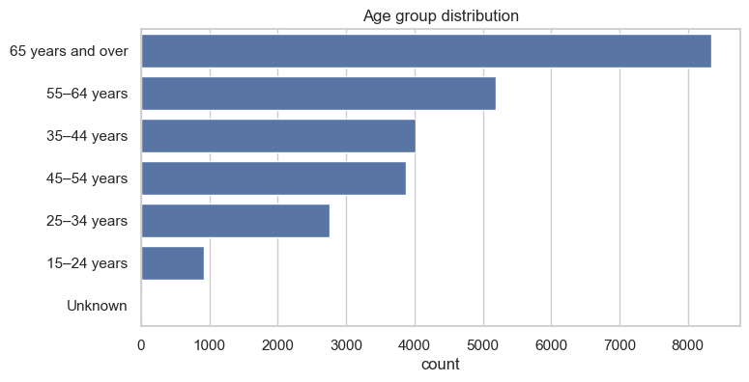
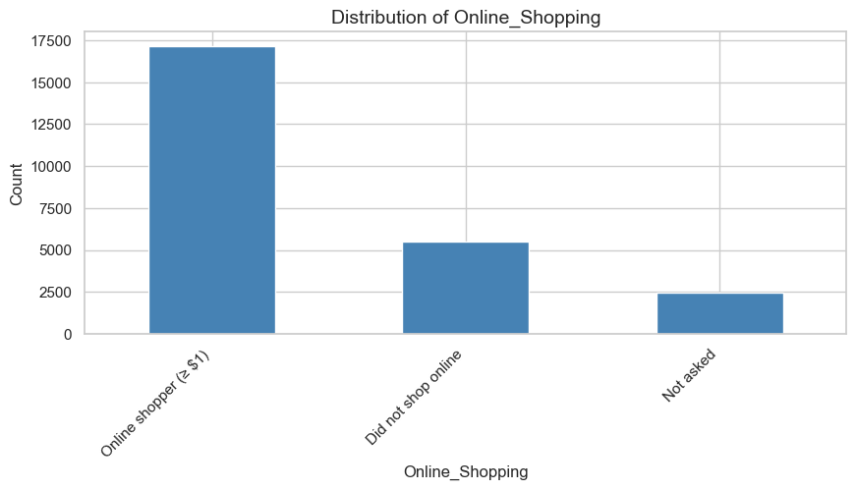
EDA Visuals (Univariate)
Age distribution - Individuals aged 55 and above comprise more than half of the dataset, highlighting their significant presence.
Online shopping frequency - Regional and income differences influence patterns in online shopping and digital communication.

Slide 7
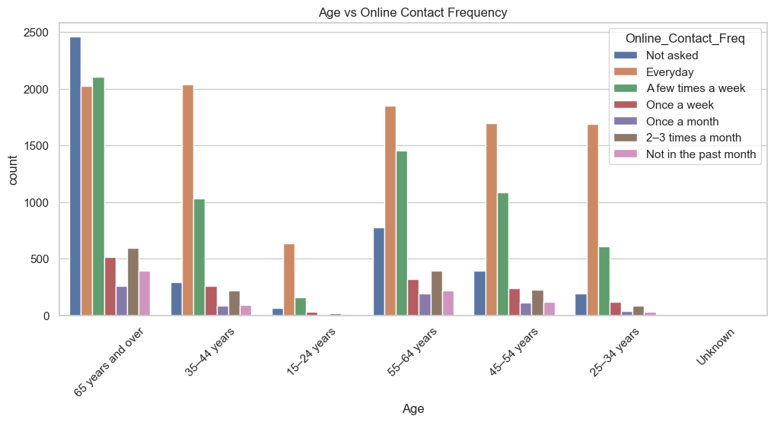
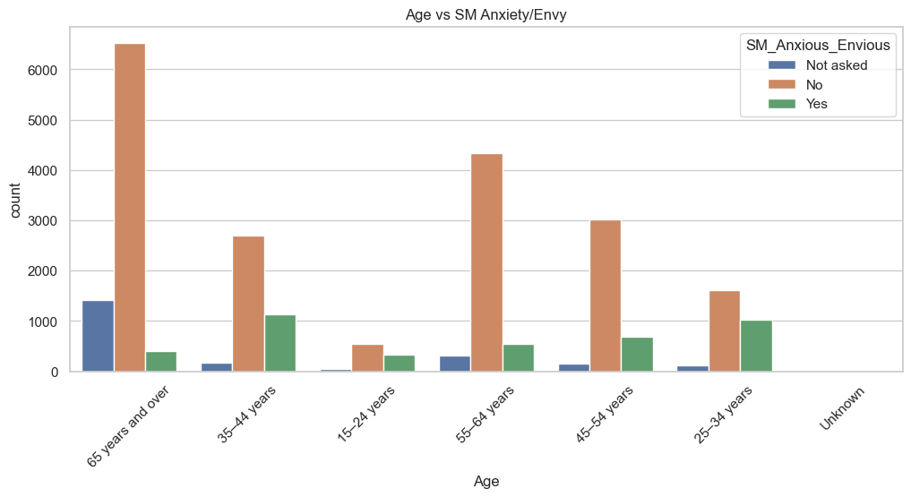
EDA Visuals (Bivariate)
Age vs Online Contact Frequency - Everyday digital communication is most common among:
25–34 years
35–44 years
Age vs Online Emotional Impact(Anxiety/Envy )- Younger adults aged 15-34 report higher anxiety and envy from social media compared to older groups.

Slide 8
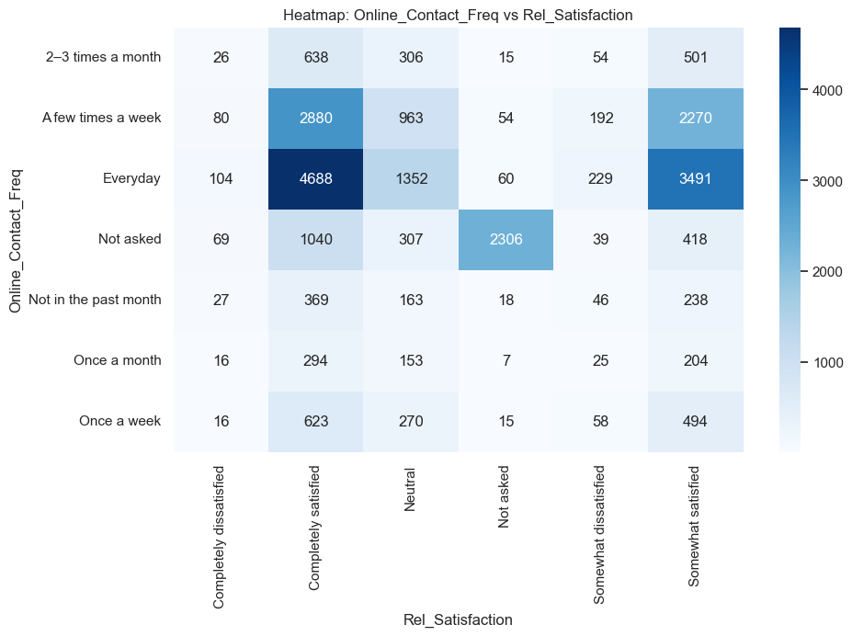
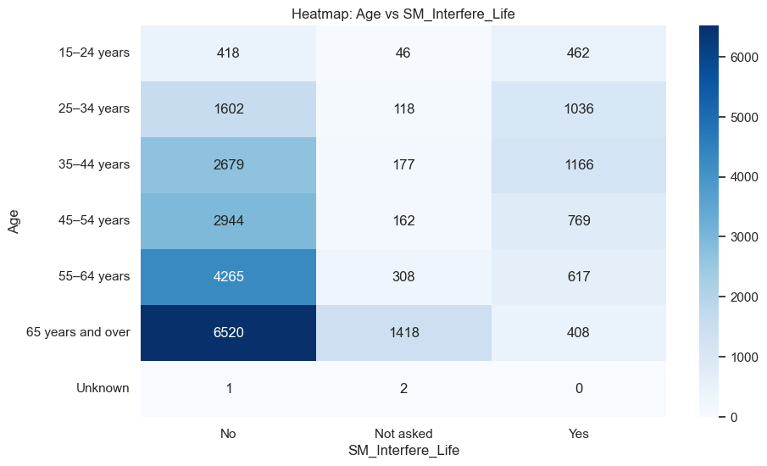
EDA Visuals (Heatmap)
Heatmaps:
Contact Frequency vs Relationship -Satisfaction - People who talk online everyday have a strong cluster in completely satisfied
Age vs Social Media Interference with Life

Slide 9
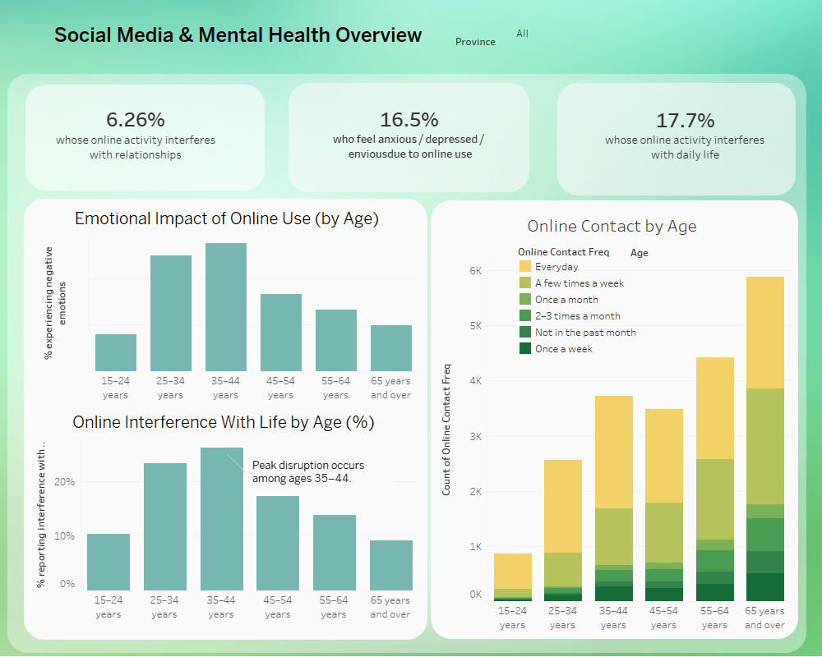
Dashboard 1 Overview
6.26% whose online activity interferes with relationships
16.5% experiencing negative emotions due to online use
17.7 % whose online activity interferes with daily life

Slide 10
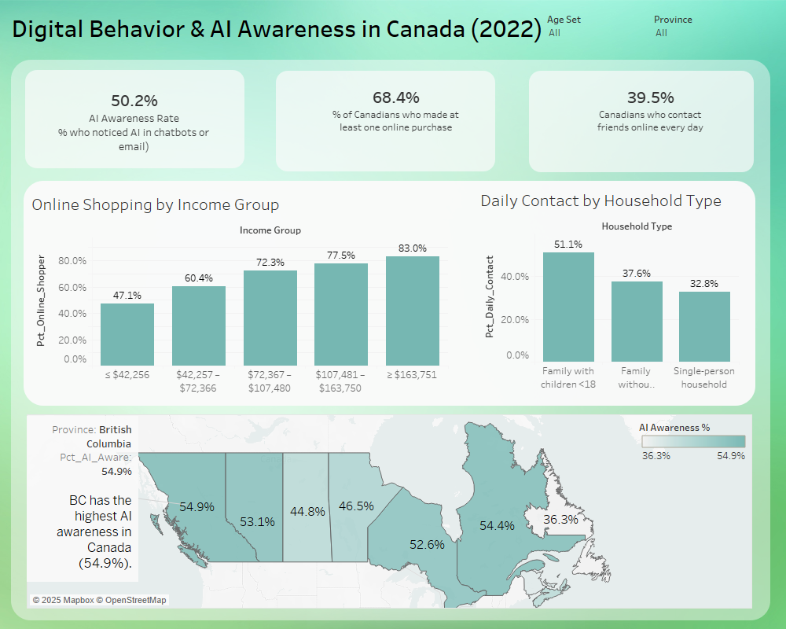
Dashboard 2 Overview
50.2% says they are aware of AI presence in Emails and chatbots
68.4% of Canadians have made at least one online purchase.
39.5% says that they try to keep in touch with friends online
Next

Slide 11

01
25–44 age group shows highest emotional impact
02
Online interference with daily life peaks among mid-life adults
Key Insights
6–17% of Canadians report emotional or life disruption
03
04
Older adults use digital contact heavily — but feel less emotional strain
05
Younger and mid-life users show more anxiety/envy from online content
06
Seniors 65+ have high online contact, mostly for family connection
07
Digital media is both a connector and a stressor!
05

Slide 12
Challenges
Missing data in some demographic groups
Self-reported emotional indicators
No time-series data to see trends
Recommendations
Develop digital well-being programs for working-age adults
Add emotional strain screening tools in digital platforms
Increase AI literacy in provinces with low awareness
Collect richer mental health variables in future CIUS cycles

Slide 13
Future Work + Conclusion
Compare digital use before vs after pandemic
Add social media sentiment analysis
Build predictive models for “digital emotional risk”
Track social media behavior over multiple years
Conclusion:
Mid-life Canadians show the most emotional challenges — highlighting the need for digital wellness initiatives.

Slide 14
Thank you

